Slide 1


Financial Highlights
As of April 30, 2024
One Minute Report – Click Below
https://www.showme.com/sh?h=L82d6eG

Slide 2

Highlights of Interim Financial Report (Unaudited)
April 30, 2024

Slide 3



Posted on Our Website
Finance / Monthly Finance Reports (hcde-texas.org)
Linked from State Comptroller’s website
http://www.texastransparency.org/local/schools.php

Slide 4

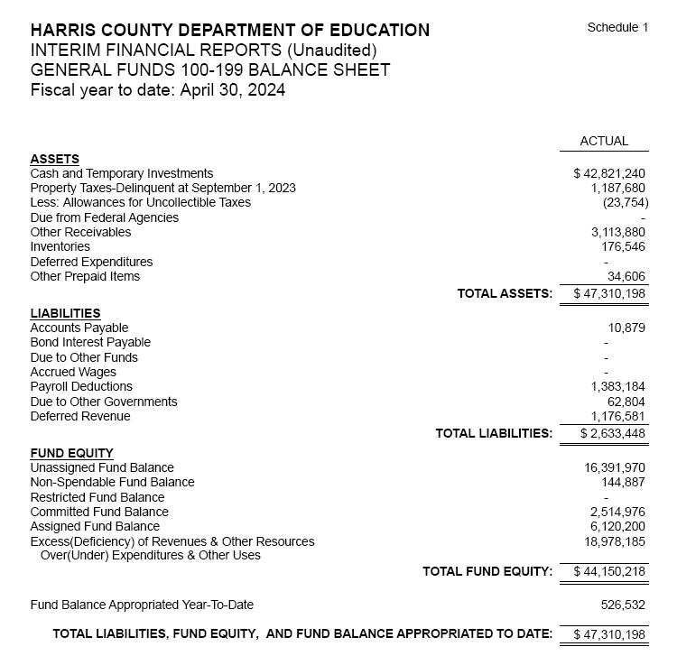
INTERIM FINANCIAL REPORT
(Unaudited)
GENERAL FUND
Balance Sheet as of April 30, 2024
Total Assets:
$ 47,310,198
Total Liabilities:
$ 2,633,448
Total Fund Equity:
$ 44,676,750

Slide 5
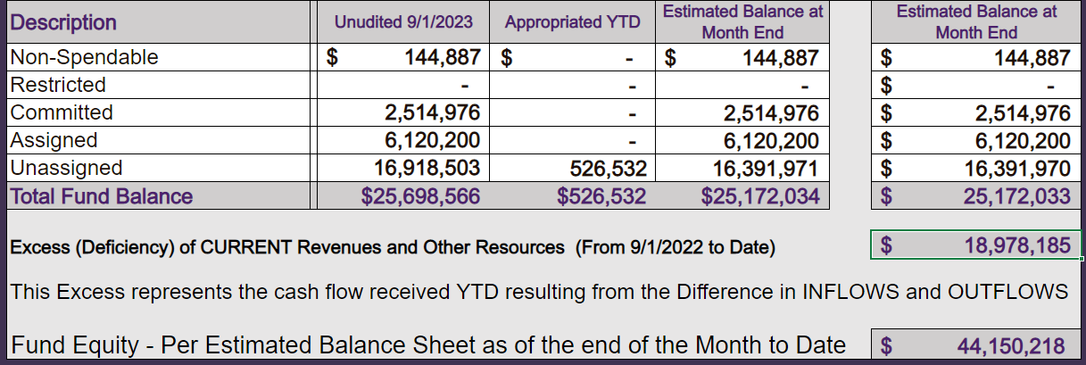
INTERIM FINANCIAL REPORT (Unaudited)
ASST. SUPERINTENDENT FOR BUSINESS SERVICES MESSAGE
As of April 30, 2024
The ESTIMATED General Fund balance at 04/30/2024 is $44,150,218 after current appropriations.
As year end adjustments are completed, a budget amendment will be submitted to the board for items assigned, restricted and committed that will roll forward into FY 2024.

Slide 6
INTERIM FINANCIAL REPORT (Unaudited)
As of April 30, 2024
Financial Ratios
Level One - Indicator of Financial Strength
Level Two - Indicator of Efficient Leverage
Level Three - Indicators of Efficiency
Level Four - Indicators of Revenue Growth

Slide 7
INTERIM FINANCIAL REPORT (Unaudited)
As of April 30, 2024
Indicators of Financial Strength
Percent of Fund Balance to G/F
Expenditures Ratio
What is the percent of rainy-day fund balance?
(*) Unadjusted
Working Capital Ratio
What is the cash flow availability for the organization?
Unassigned Fund Balance $ 16,391,970
Total G/F Expenditures $ 41,003,882
Goal : > 30% of G/F Exp.
Benchmark: 10% to 29%
Danger: Under 10%
Goal : >$15,000,000
Benchmark : $10M to $15M
Danger : Under < $10M
Total Current Assets
Less Total Current Liabilities
$47,310,198 -2,633,448= $44,676,750
40% FY24
41% FY23
$45M FY24
$35M FY23
Budgeted 24%
Details on Schedule 3
Budgeted $33M
Details on Schedule 1

Slide 8
INTERIM FINANCIAL REPORT (Unaudited)
As of April 30, 2024
Indicators of Efficient Leverage Reserves
Budgeted Payments $3.8M
Current $2.9M
Unassigned Fund Balance Ratio
How much is available in reserves?
Debt to Income Ratio
What is the ability of HCDE to cover
its debt payments?
Unassigned Fund Balance $16,391,970
Total Fund Balance $44,676,750
Annual Principal and Interest Payments on
Term Debt and Capital Leases : $2,234,636
G/F Revenue Less Facility $59,982,066-4,567,246
Charges :
Goal: <75%
Benchmark: 50% to 75%
Danger: <50%
Goal: <25% of annual revenue
Benchmark: 25% to <49%
Danger: Over > 50%
37% FY24
48% FY23
4% FY24
6.4% FY23
Budgeted 71%
Details on Schedule 1
Budgeted 6%
Details on Schedule 5

Slide 9
INTERIM FINANCIAL REPORT (Unaudited)
As of April 30, 2024
Indicators of Efficiency
Tax Revenue to Total Revenue Ratio
How efficient is HCDE at leveraging local
taxes? (Current)
Indirect Cost to Tax Ratio
How much dependency on indirect cost from grants?
Current Tax Revenue $ 30,089,194
Indirect Cost General Fund $1,295,584
Total Revenue $ 112,407,896
Total General Fund Revenues $59,982,066
Total General Fund Revenues $1,306,381
Goal: <20% of revenue
Benchmark: 20% to 30%
Danger: Over >30%
Goal: >5%
Benchmark: 2% to 5%
Danger: Under < 2%
Goal: >5%
Benchmark: 2% to 5%
Danger: Under < 2%
27% FY24
33% FY23
2.2% FY24
2% FY23
Budgeted 25%
Details on Schedule 2
Budgeted 2.5%
Details on Schedule 3

Slide 10
INTERIM FINANCIAL REPORT (Unaudited)
As of April 30, 2024
Indicators of Revenue Growth
Fee for Service Revenue Ratio
How are revenues spread across all Funds?
Fee for Service Revenue Growth Ratio
What is the market growth for fee on services?
Total Fee for Service Revenues (G/F) $21,251,616
Total Revenues $112,407,896
Fee for Service Current Year Less Fee for Services Last Year $21,251,616-16,877,392
Fees for Service Last Year $16,877,392
Goal: >30% of annual revenue Benchmark: 10% to 29%
Danger: Under 10%
Goal: >3% of + growth
Benchmark: 0% to 3%
Danger: Under 0%
19% FY24
20% FY23
26% FY24
12% FY23 ​
Budgeted 19%
Details on Schedule 14
Budgeted 17%
Details on Schedule 14

Slide 11
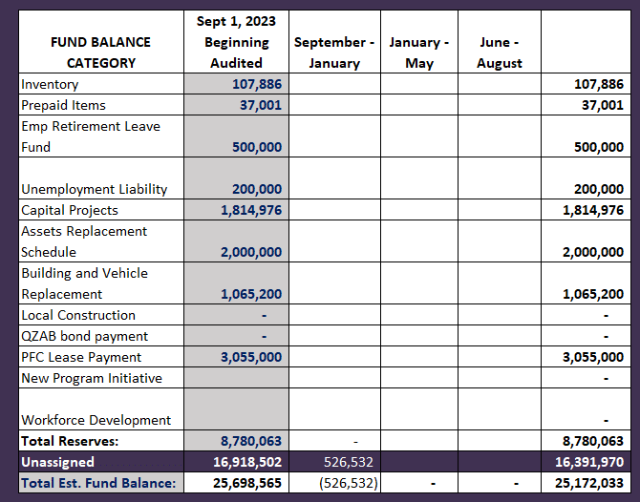
FY 2023-2024
Fund Balance
-
Budgeted Activity

Slide 12
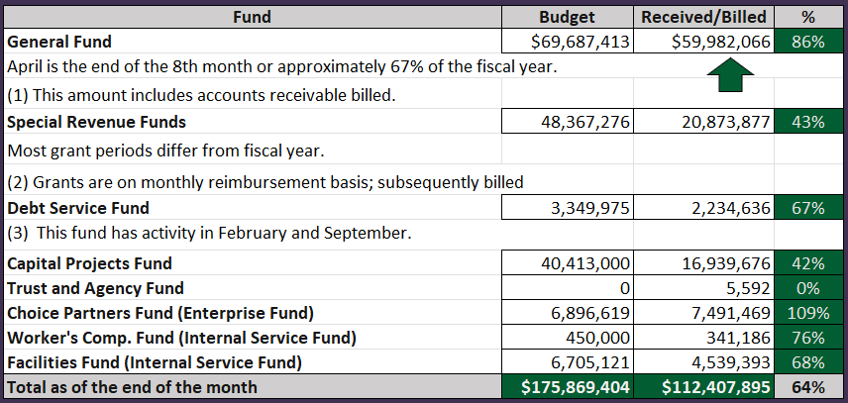
INTERIM FINANCIAL REPORT (Unaudited)
GENERAL FUND, SPECIAL REVENUE, DEBT SERVICE FUNDS, CAPITAL PROJECTS,
AND INTERNAL SERVICE FUNDS
REVENUES (INFLOWS)
Budget to Actual for period ending April 30, 2024

Slide 13
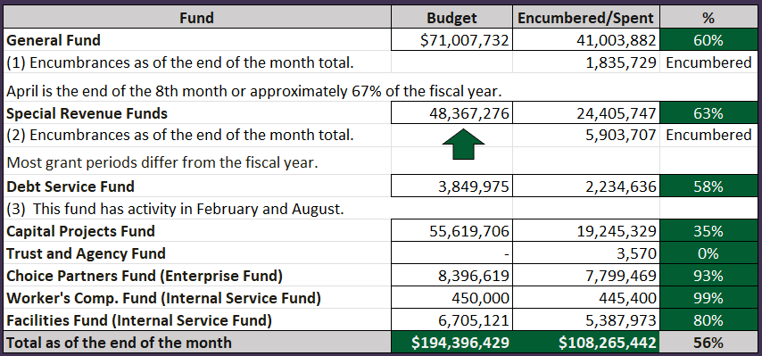
INTERIM FINANCIAL REPORT (Unaudited)
GENERAL FUND, SPECIAL REVENUE, DEBT SERVICE FUNDS, CAPITAL PROJECTS,
AND INTERNAL SERVICE FUNDS
Expenditures (OUTFLOWS)
Budget to Actual for period ending April 30, 2024

Slide 14
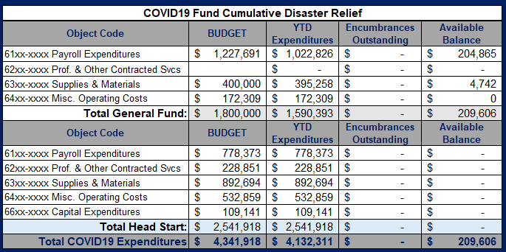
INTERIM FINANCIAL REPORT (Unaudited) FY 2021 – 23 COVID19 Budget to Actual – Expenditures
for period ending April 30, 2024
Head Start grants ended by August 31st, 2023. All funds were drawdown and final reports will be submitted.
All HCDE covid funds are committed for the current fiscal year

Slide 15
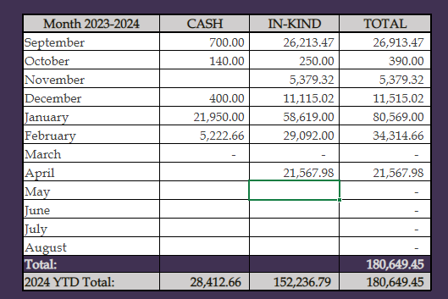
INTERIM FINANCIAL REPORT (Unaudited)
FY 2023-24 Donations Report
All Funds as of April 30, 2024

Slide 16
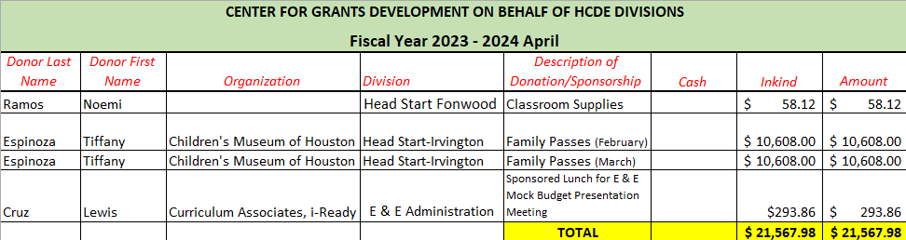
INTERIM FINANCIAL REPORT (Unaudited)
FY 2023-24 Donations Report
All Funds as of April 30, 2024

Slide 17
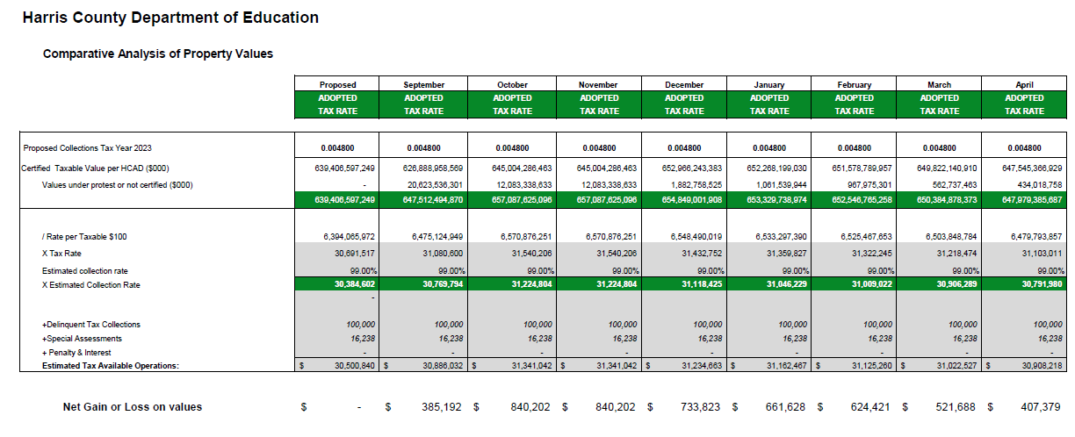
INTERIM FINANCIAL REPORT (Unaudited)
TAX COLLECTIONS COMPARATIVE ANALYSIS
Fiscal Year-To-Date as of April 30, 2024
$647.9B
See Tax Calculator at:
https://hcde-texas.org/transparency/tax-rate/
17

Slide 18
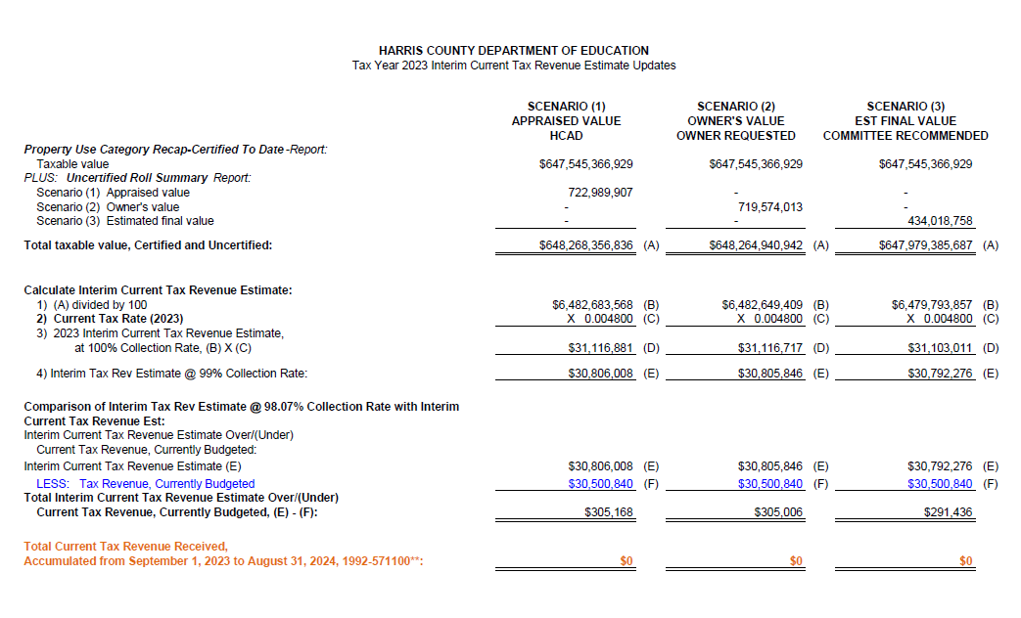
INTERIM FINANCIAL REPORT (Unaudited) TAX COLLECTIONS
Fiscal Year-To-Date as of April 30, 2024
(8th month / 12 months)

Slide 19
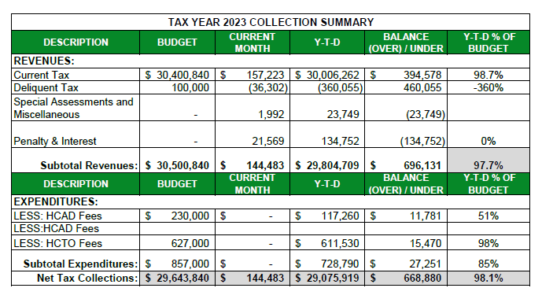
INTERIM FINANCIAL REPORT (Unaudited) TAX COLLECTIONS
Fiscal Year-To-Date as of April 30, 2024
(8th month / 12 months)
a) 2023 Proposed Tax Rate = $0.004800/$100 Property Assessment/Appraisal - --> Annual Tax on a $259,375 - $75,219 = $201,066/100
x .004800 = $9.65 (net of 29% homestead exception.)
b) $705,000/$30,500,840 = 2.32% Collection and assessment costs

Slide 20
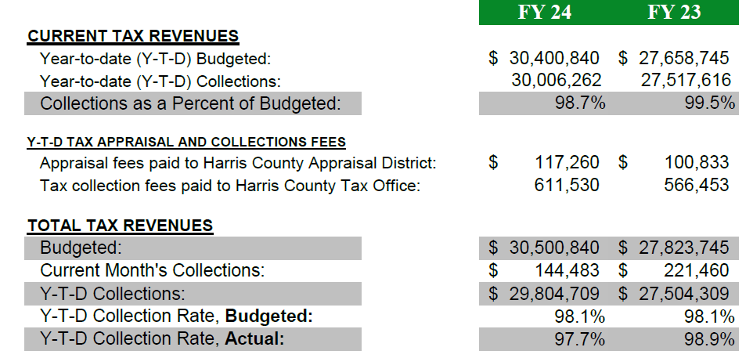
INTERIM FINANCIAL REPORT (Unaudited) TAX COLLECTIONS
Fiscal Year-To-Date as of April 30, 2024
(8th month / 12 months)
2022 Adopted Tax Rate = $0.004900/$100 Property Assessment/Appraisal - --> Annual Tax on a $259,375 - $75,219 = $201,066/100 x .004900 = $9.85 (net of 29% homestead exception.)
b) $705,000/$25,188,000 = 2.80% Collection and assessment costs

Slide 21
INTERIM FINANCIAL REPORT (Unaudited)
DISBURSEMENT – ALL FUNDS
April 30, 2024
Notes:
All Purchase Orders and Payment Authorizations are reviewed before disbursement.
All Procurement Card charges are reviewed by cardholder, supervisor, and business office staff each month.
A report on CH Local Expenditures is included in the monthly report.

Slide 22
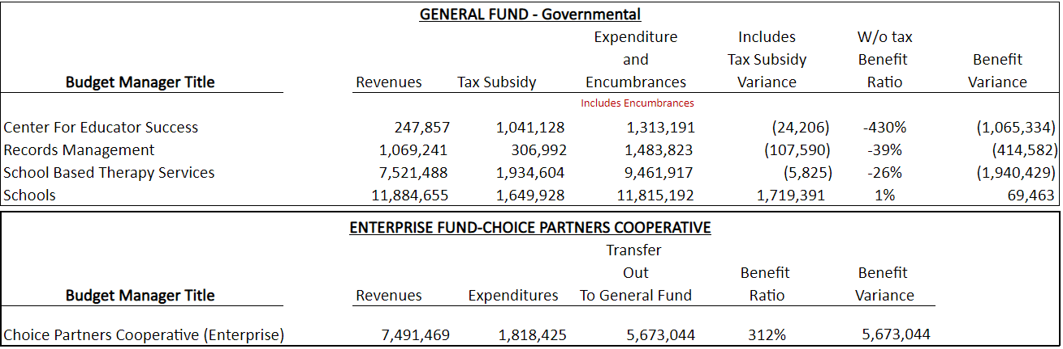
INTERIM FINANCIAL REPORT (Unaudited)
Segment Division Data
As of April 30, 2024

Slide 23
HIGHLIGHTS OF BUDGET AMENDMENT REPORT
May 15th Board Meeting
(Unaudited)
Amendments
No Budget Amendments for the month of May

Slide 24

Education Foundation Update
April 30, 2024

Slide 25
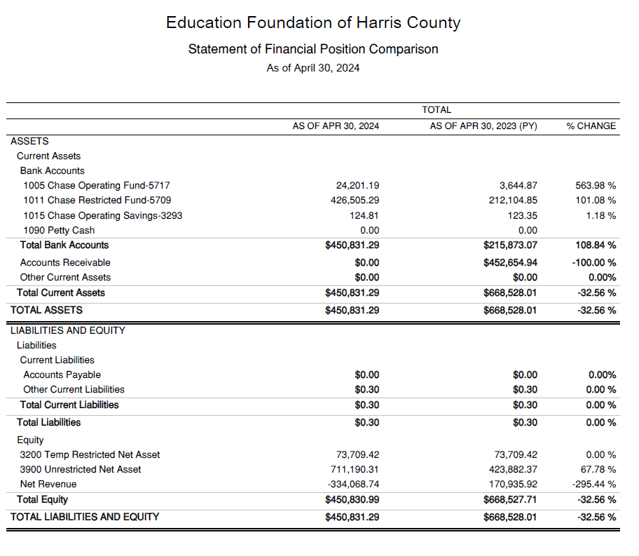
Statement of Financial Position
Net Equity $450,831

Slide 26
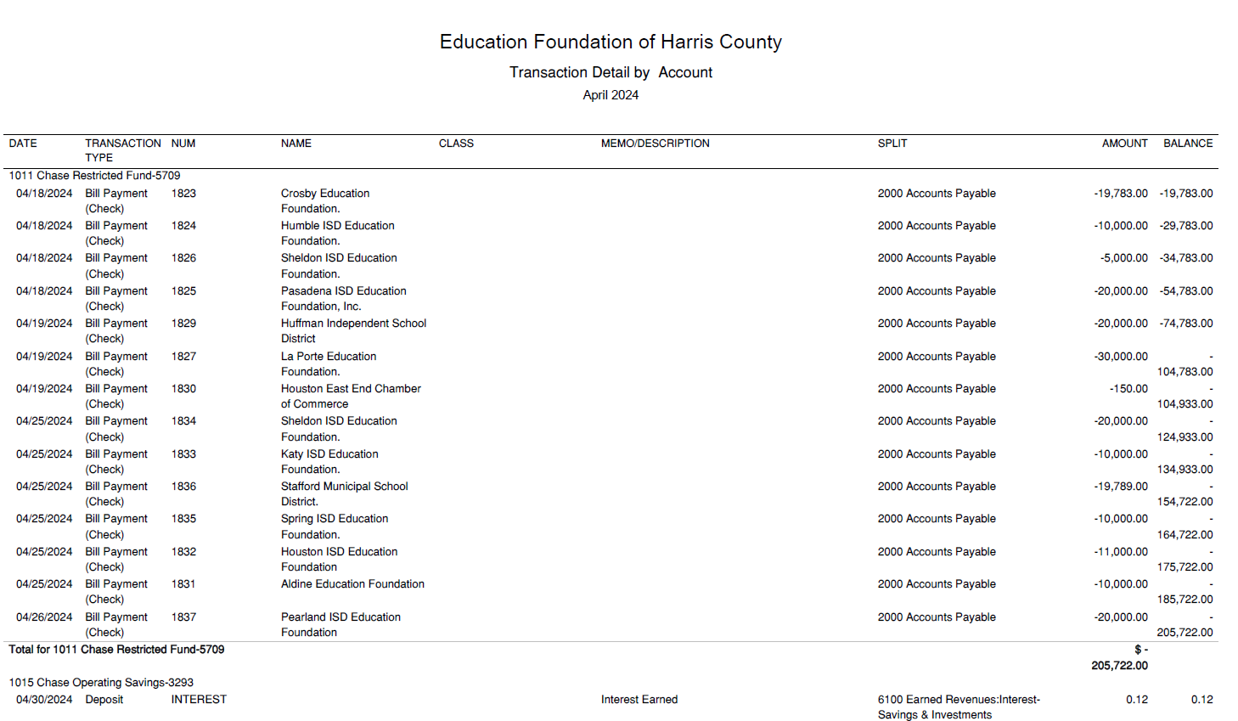
Transaction Detail by Inflow & Outflow

Slide 27
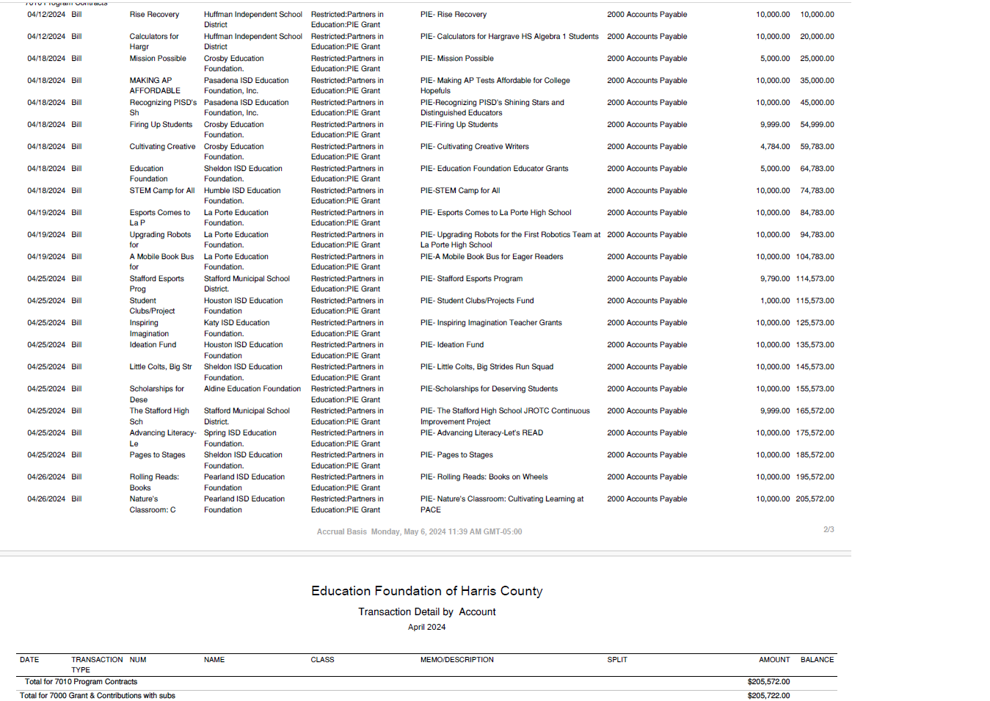
Transaction Detail by Inflow & Outflow

Slide 28
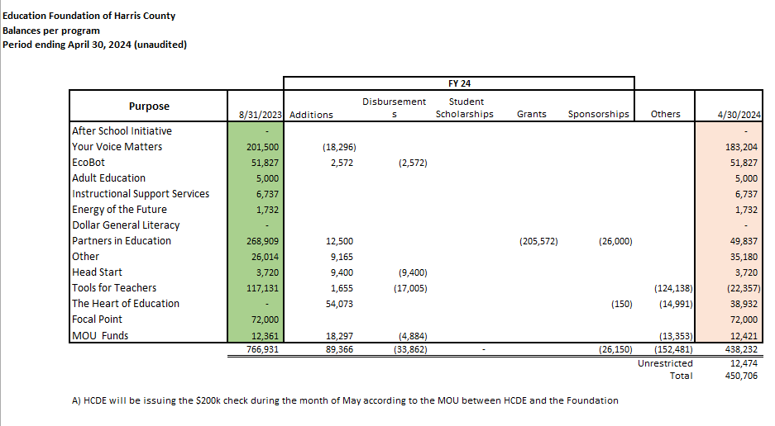
Balances Per Program

Slide 29

PFC & Lease Revenue Projects Update
April 30, 2024

Slide 30
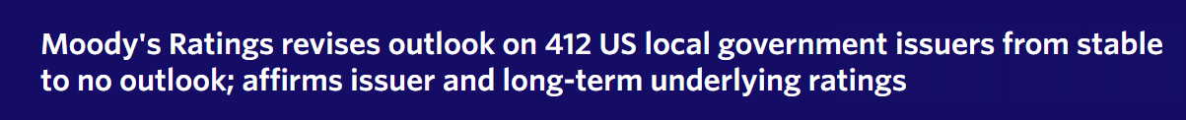
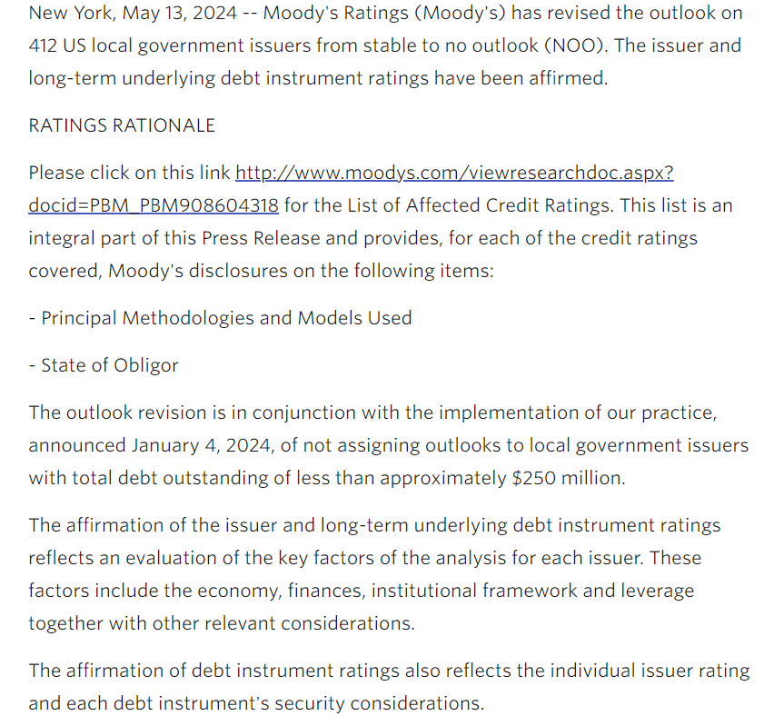
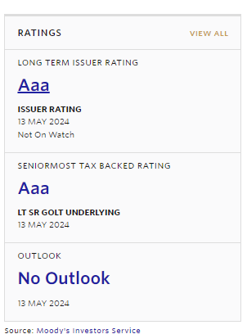

Slide 31
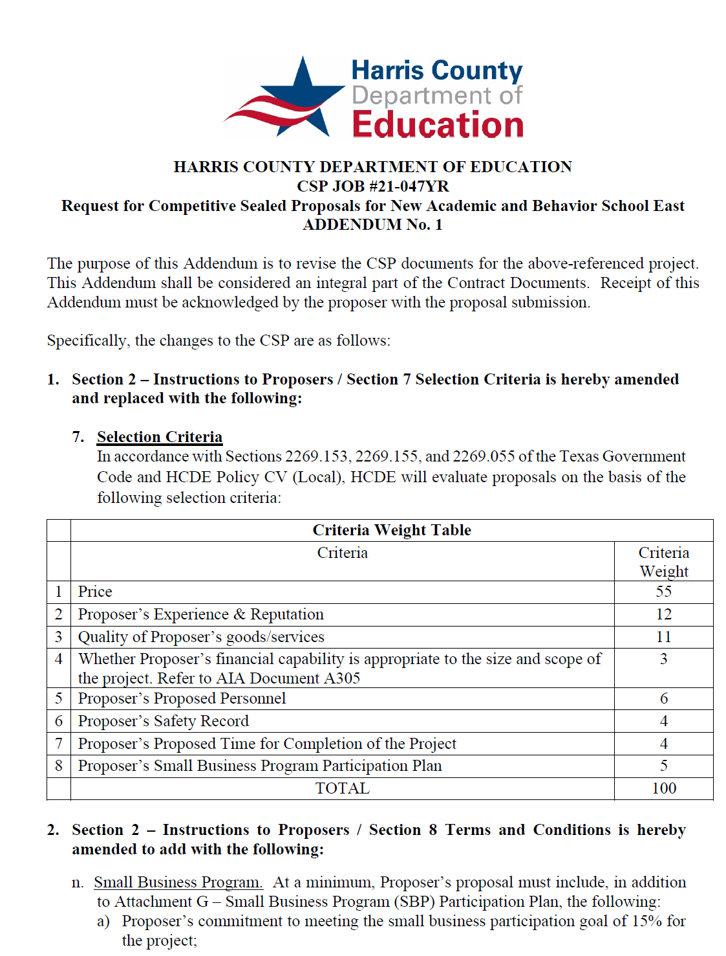
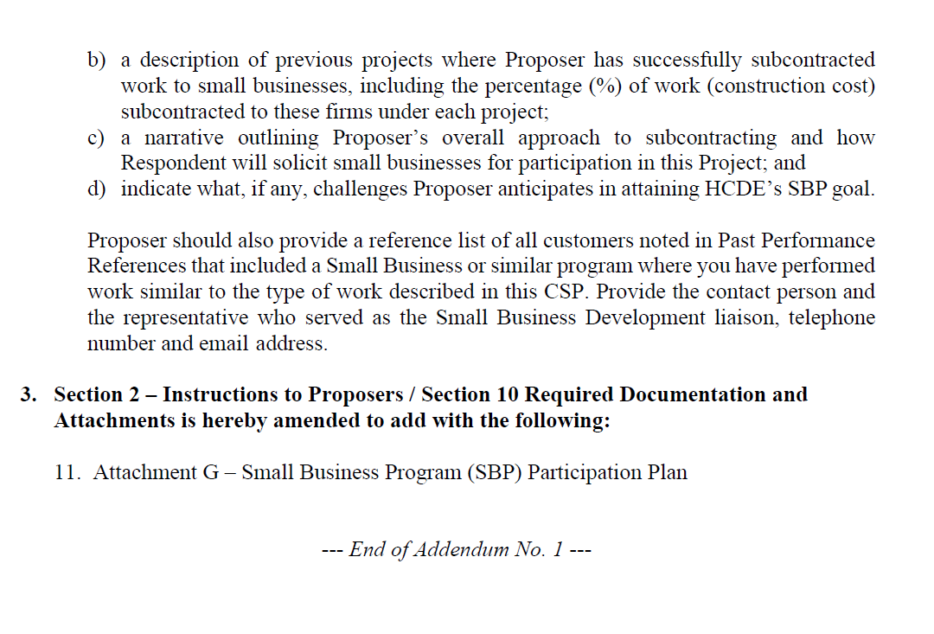
Small Business
Program for construction
Launch industry's first collaboration feature
This is our plan as we launch the industry's first collaboration feature

Slide 32
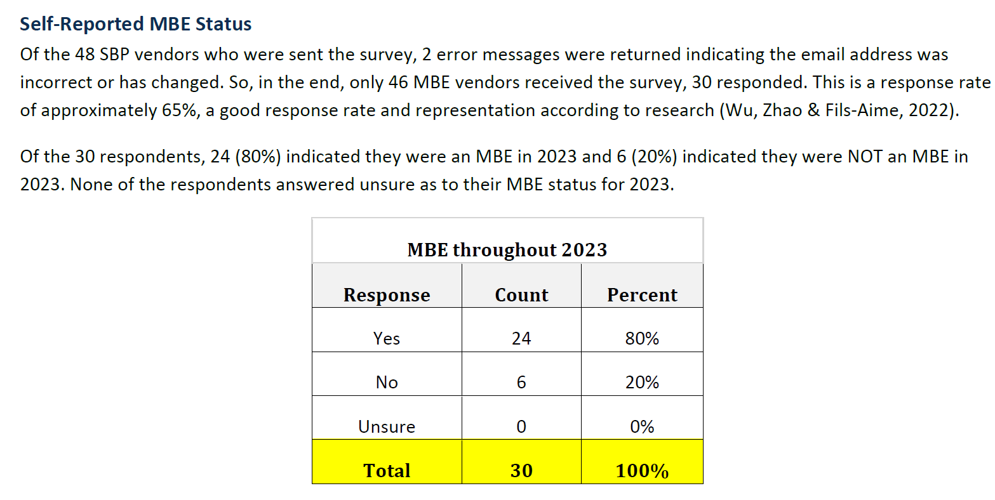
Small Business Program
65% Survey Response Rate
FY 2023 Update as of April 30, 2024

Slide 33
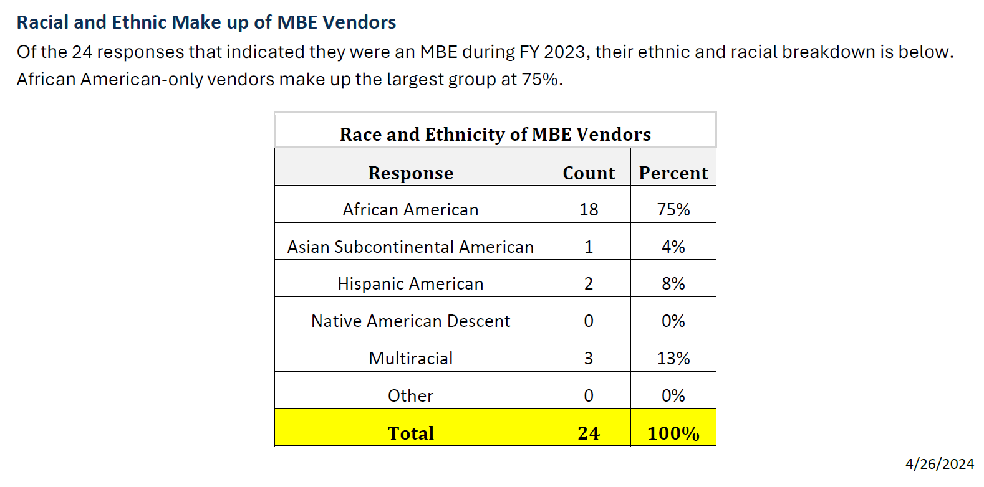
Small Business Program
75% One category
FY 2023 Update as of April 30, 2024

Slide 34
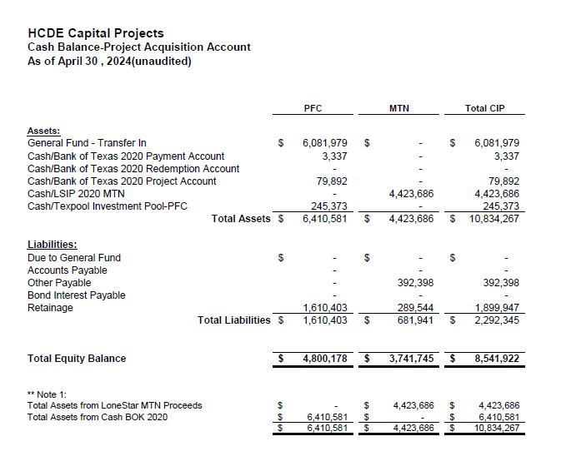

AB East School Contract $12,358,000 Awarded and Signed
Adult Ed Center Contract $15,121,000 awarded on Oct 2021 Board Mtg
HP East Contract $7,271,000 awarded on Nov 2021
Irvington – Pending Architect Assignment
Cash Balance –
Project Acquisition Account
As of April 30, 2024

Slide 35
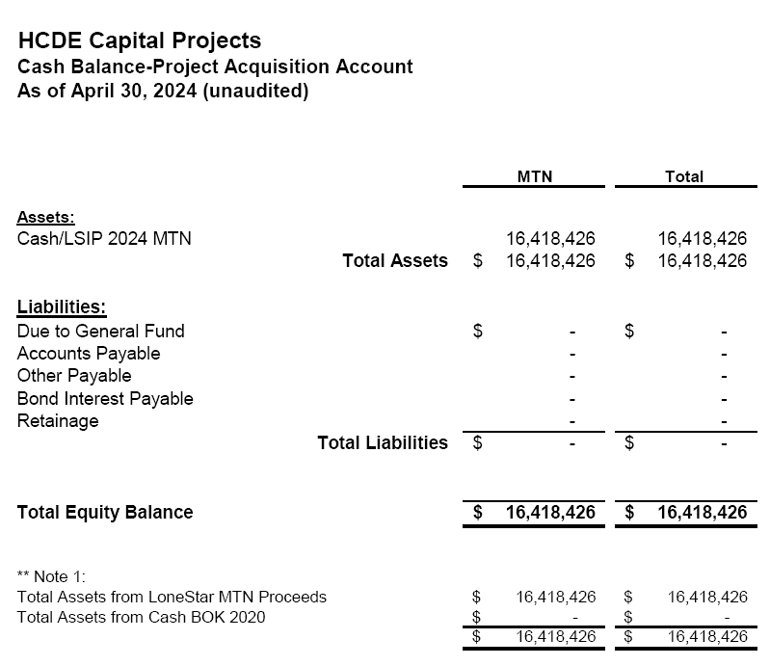
AB West $333,000 March 2024 Board Mtg
HS Barrett Station $470,000 March 2024 Board Mtg
Fortis Academy $650,000 March 2024 Board Mtg
Irvington – $9,860,000 March 2024 Board Mtg
Post Oak - $5,000,000 March 2024 Board Mtg
Cash Balance –
2024 Maintenance Notes
As of April 30, 2024

Slide 36
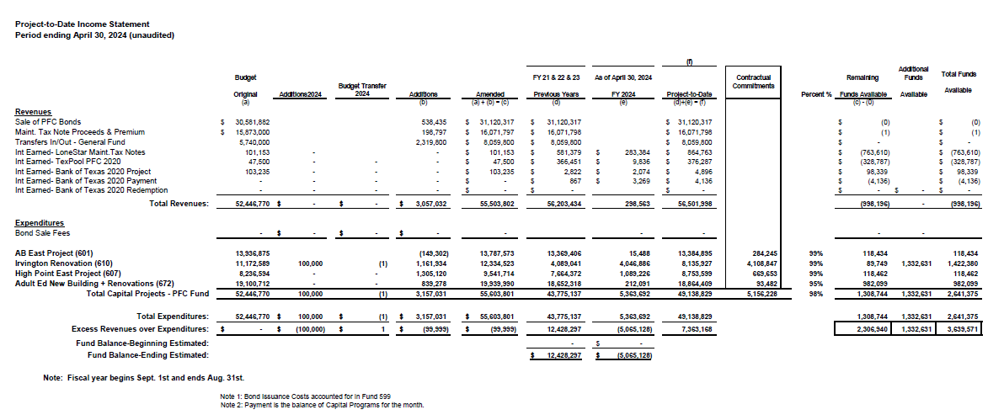
Income Statement– Project Acquisition Account
As of April 30, 2024

Slide 37
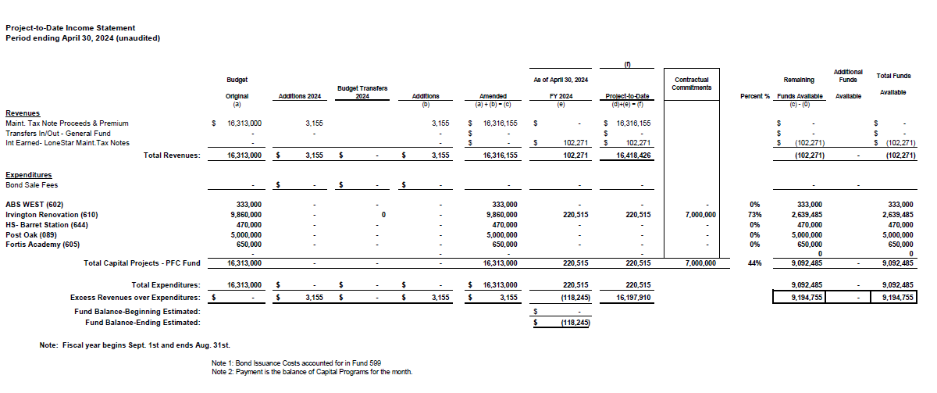
Income Statement– 2024 MNT NOTES
As of April 30, 2024

Slide 38
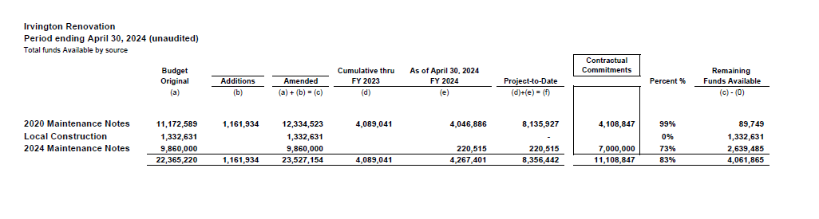
Irvington Renovation – Funds by Source
As of April 30, 2024
38

Slide 39

Capital Program Proposal from Aug 3, 2020
39

Slide 40






2020 Projected Capital Improvement Program
Project | Substantial Completion Date | Project Budget | Maintenance Notes Projected | Revenue Bonds Proceeds | General Funds Use of Fund Bal. | Interest Earnings Projection
Reagan Adm Bldg. | Feb 9, 2023 | $8,365,500 | $ 8,365,500 | N/A | N/A
Adult Ed Building | Oct 25, 2022 | $18,358,750 | $ 3,659,000 | $12,728,598 | $1,870,000 | $101,153
HP East Middle | Oct 25, 2022 | $7,916,645 | $ 1,089,500 | $4,909,645 | $1,870,000 | $47,500
Ab East Campus | Aug 16, 2022 | $17,805,875 | $ 2,759,000 | $12,943,640 | $2,000,000 | 103,235
 | Total | $52,446,770 | $15,873,000 | $30,581,882 | $5,740,000 | $251,888
 |  | Closed on 12-2-20 | Invested in pools.
Build a product accessible on all devices
This is our plan as we build a product accessible on all devices.
Note: The Total Public Notice was $54,000,000. ($35,000,000 for Revenue bonds and $19,000,000 for Maintenance Notes) on August 10, 2020. A transfer of $1,350,000 plus $50,000 in reimbursable expenditures was made from AB East to allocate Program Manager costs to establish the budgets.
Based on Pricing the principal amount will vary due to the premium projected in the bond sale. Revenues Bonds estimated at $27,730,000 and Maintenance Notes for $13,695,000

Slide 41

Interim Financial Report (Unaudited)
I certify that the foregoing information is true and accurate to the best of my knowledge.
/s/ Jesus J. Amezcua, RTSBA,CPA, Ph.D., CPFIM, Asst. Supt. for Business Support Services
/s/ Marcia Leiva, Chief Accounting Officer

